Slide 1
Public Entity Executive Remuneration Survey (PEERS)
Quick reference guide

Slide 2
1. Getting started – Select your Active survey
Click on the name of your organisation’s active survey to enter the survey.
If you are allocated more than one survey they will all be listed here
Click on the down arrow to view historical surveys.
The number of executive details that have been submitted within PEERS

Slide 3
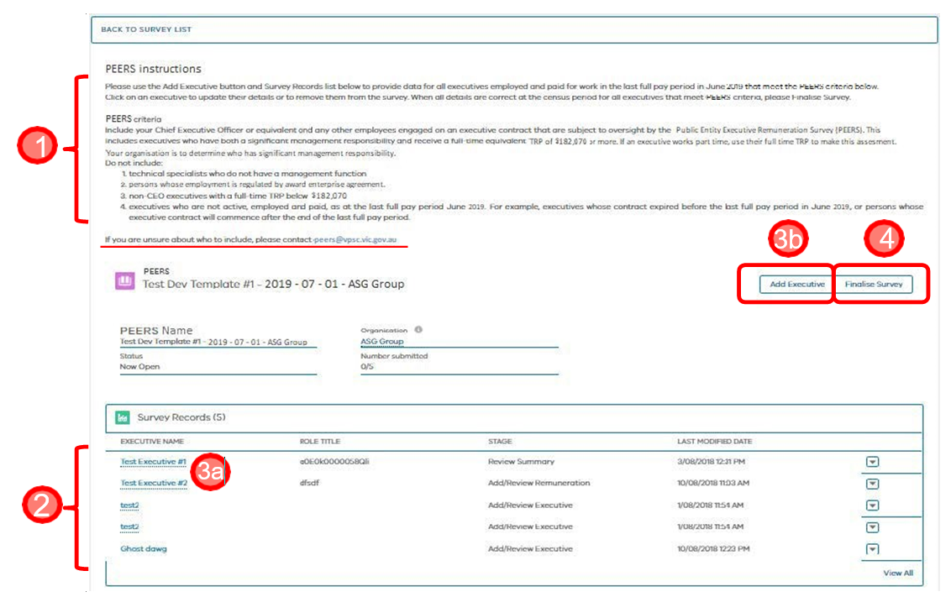
2. Managing your survey
Please note the census window and PEERS criteria for execs to include in the survey
Review list of previously reported executives with respect to census window and PEERS criteria
a) Click on each executive and review and update their data with respect to census window and PEERS criteria b) Add executive’s who were employed and paid at the census window who meet PEERS criteria c) Edit executive status
Finalise your survey when details for all executives that meet the above criteria have been reviewed, validated and submitted.

Slide 4
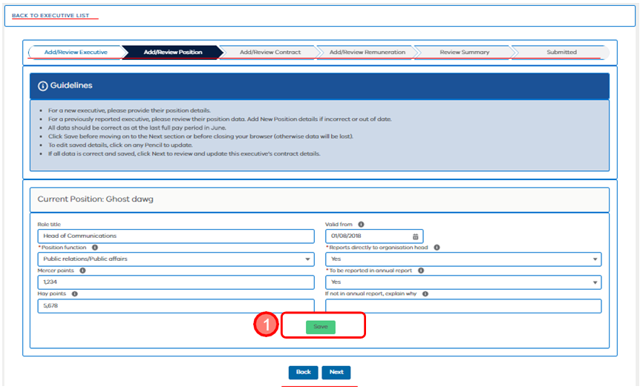
The ‘Save’ button
‘Save’ as you go. You will lose all data entered, if you do not save before clicking:
‘Back’ or ‘Next’ or ‘Back to Executive List’
A different chevron
Back on your browser or close your browser.

Slide 5
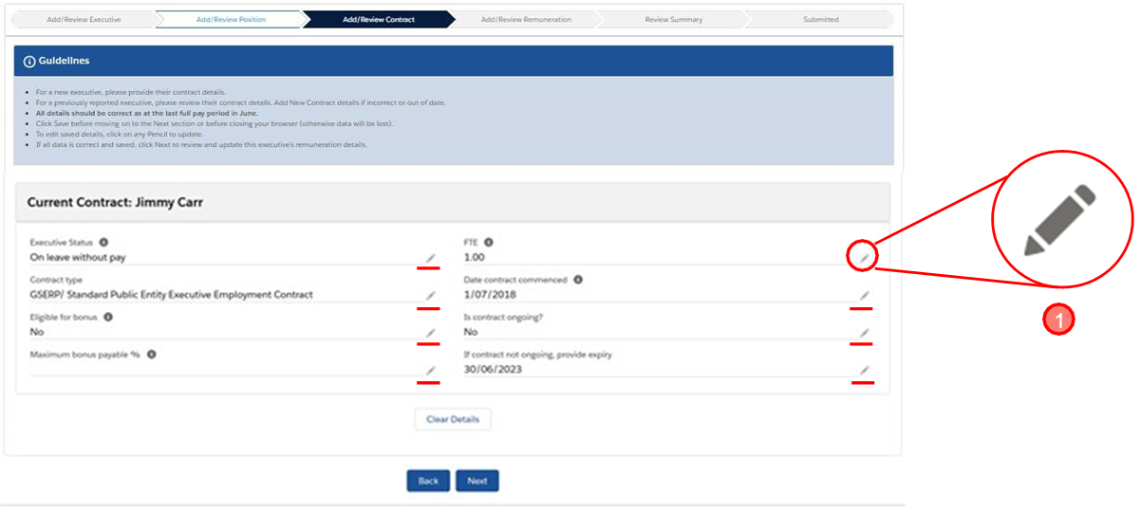
Use pencils to edit saved data
Click on a Pencil to edit saved details

Slide 6
Executive status
Click on the drop down arrow to see a list of executive status options.
Select the applicable executive status from the drop down list.

Slide 7
Implicit errors
Implicit errors such as illogical dates, will show next to the field. You will not be able to ‘Save’ data if they are not fixed by entering correct information.
If you click ‘Back to the Executive List’ or click ‘Back’ or ‘Next’ to another page, you will lose all data entered if you have not fixed and saved the data.

Slide 8
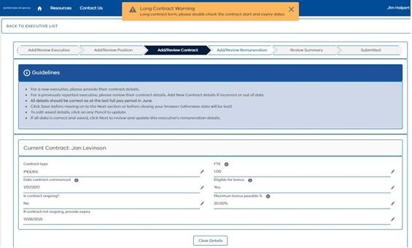
Other error and warning messages
Some errors and warnings pop up as highlighted.
If you fix the issue, by correcting data entered, or confirm the warning as correct – click ‘X’ to remove the pop up message
The message may continue to pop up, if the conditions that generate the message are unchanged
Warnings in yellow boxes will not prevent submission
Errors in red boxes will need to be fixed to enable submission
A summary of any errors or warnings will be presented on the ‘Review Summary’ chevron/page

Slide 9
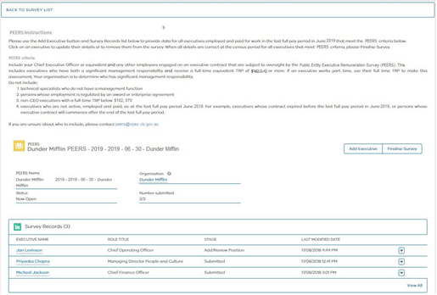
Finalising your survey
Once you have provided accurate data for all executives that meet the PEERS criteria. On the page that lists executives, select ‘Finalise Survey’.
The ‘Status’ will change to ‘Closed’ and you will not be able to add or edit executive information.
Contact the VPSC at peers@vpsc.vic.gov.au if you need to unlock the survey to make changes
When you go ‘Back to survey list’ no active surveys will be listed. Select ‘Historic’ to review what was provided.

