Slide 1
People matter survey wellbeing check 2022 results
Using and understanding your results dashboards

Slide 2
What we plan to cover
How to access your People matter survey wellbeing check 2022 results dashboards
What result dashboards you have access to
How to navigate your dashboards
How to export your results
Where can I get more information?

Slide 3
Introduction
In 2022, your People matter survey wellbeing check results are available as online interactive dashboards.
This presentation will help you understand:
How to access your 2022 online dashboard results.
What dashboards you have access to.
How to navigate the dashboards and find results for different questions.
How to export results.

Slide 4
How to access your People matter survey 2022 results dashboards

Slide 5
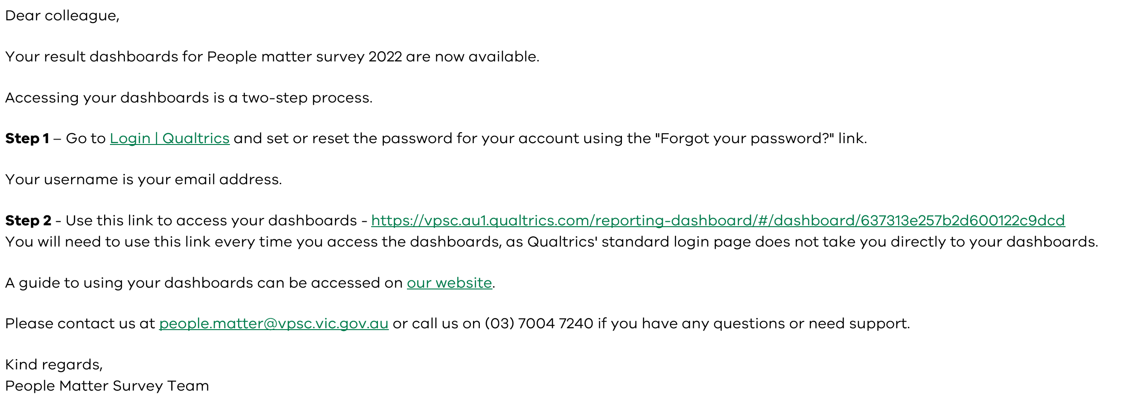
Accessing your results dashboard
You will receive an email from people.matter@vpsc.vic.gov.au with a link and login details to your 2022 dashboards.
We will send the email to your:
Head of organisation.
Head of Human Resources.
Survey coordinator.

Slide 6
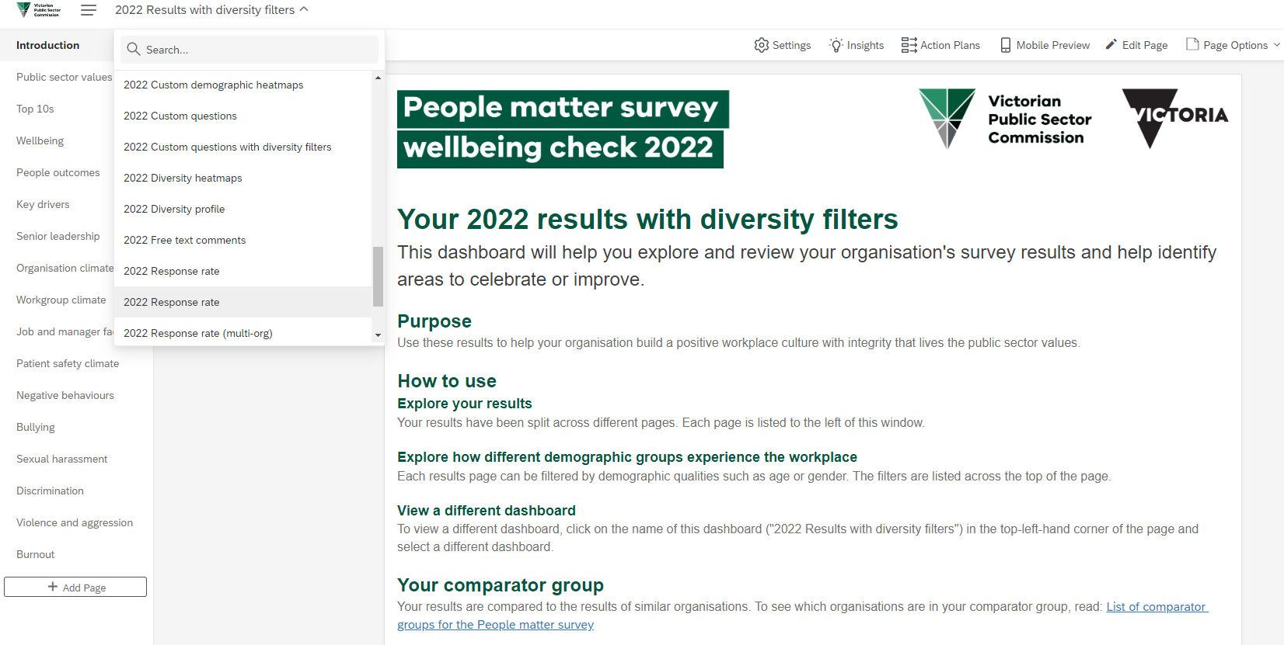
Accessing your results dashboard
Once logged in, you will have access to a range of 2022 results dashboards.
Text at the top of each page explains your results

Slide 7
What result dashboards you have access to

Slide 8
Your People matter survey 2022 dashboards overview
Dashboard | Minimum number of survey responses needed | Only available if you chose to add custom questions | Shows organisation hierarchy results if added to survey
2022 Response rate | 10 | - | Yes
2022 Results | 10 | - | Yes
2022 Results with diversity filters | 30 | - | Yes
2022 Diversity profile | 30 | - | -
2022 Diversity heatmaps | 30 | - | -
2022 Custom question results | 10 | Yes | Yes
2022 Custom question results with diversity filters | 30 | Yes | -
2022 Custom demographic heatmaps | 30 | Yes | -

Slide 9
Your People matter survey 2022 dashboards
2022 Response rate
Your organisation's overall response rate to the survey.
The response rates of any sub-units (employee groups, divisions or teams).
2022 Results
Your organisation's results with benchmarks, including comparisons with previous years and comparator group.
Hierarchy filter to provide results for teams with 10 or more responses (if you chose to add an organisation hierarchy your survey).
2022 Results with diversity filters
Only available if your organisation achieved over 30 responses.
Provides results for demographic groups with 10 or more responses.
Includes benchmarks.
No organisation hierarchy filter in line with privacy statement.

Slide 10
Your People matter survey 2022 dashboards
2022 Diversity profile
Only available if your organisation achieved over 30 responses.
The demographic profile of your survey sample.
Hierarchy filter to give profile for groups with 30 or more responses.
2022 Diversity heatmaps
Only available if your organisation achieved over 30 responses.
Enables you to compare organisation-level results for demographic groups with 10 or more survey responses.
2022 Custom demographic heatmaps
Only available if your organisation chose to include additional demographic questions in the survey.
Enables you to compare organisation level survey results for custom demographic groups with 10 or more survey responses.

Slide 11
Your People matter survey 2022 dashboards
2022 Custom questions
Only available if your organisation chose to include custom opinion questions in the survey.
Separate dashboards to allow you to filter by your organisation's hierarchy or demographics.
2022 Custom questions
with diversity filters
Only available if your organisation chose to include custom opinion questions in the survey.
Separate dashboards to allow you to filter by your organisation's hierarchy or demographics.
2022 Free text comments
Only available to the head of your organisation.
Dashboard allows you to view all verbatim comments and filter by key words and topics.
The head of organisation can request additional users to be given access to this dashboard with an email to people.matter@vpsc.vic.gov.au

Slide 12
How to navigate your dashboards

Slide 13
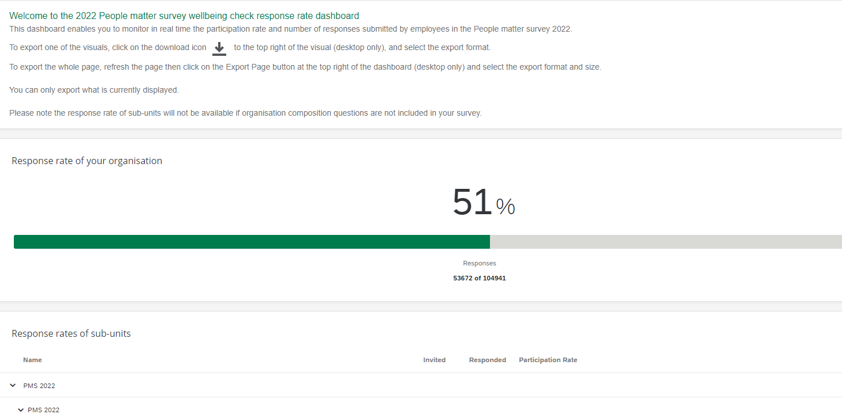
Response rate dashboard
Use the response rate dashboard to see your organisations overall response rate to the survey, along with the response rates of any sub-units.
Your 2022 response rate
Number of responses
Expand by clicking on each arrow
Sub-unit response rates

Slide 14
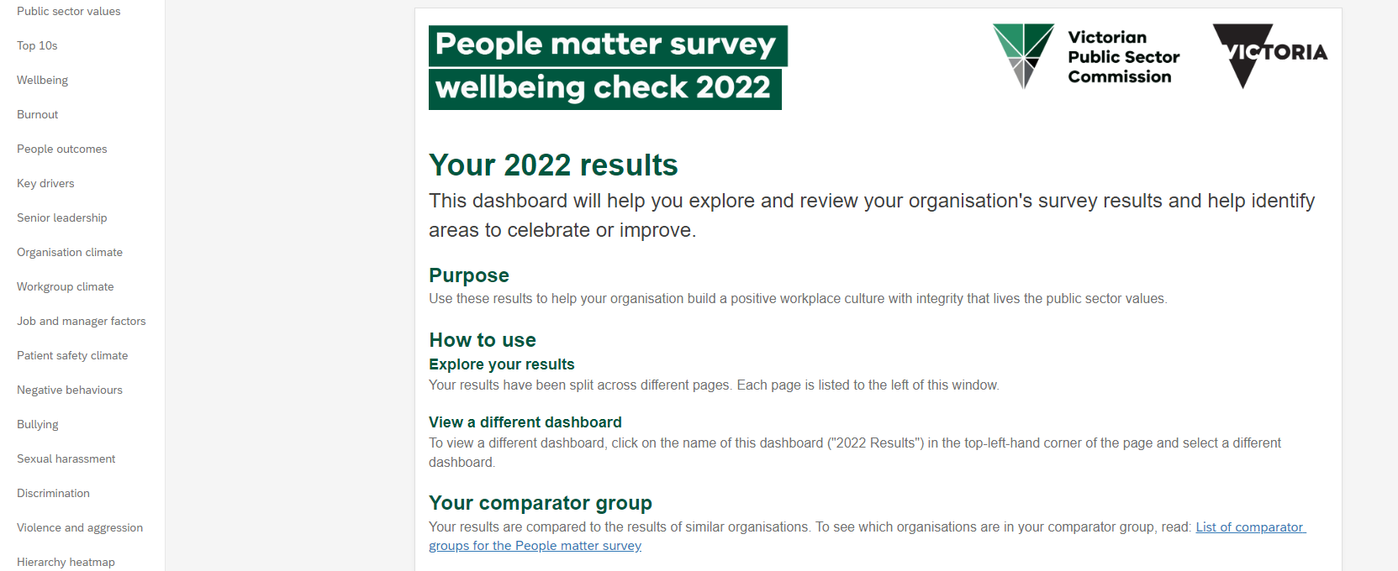
Results dashboards
Use the results dashboards to see your organisations overall results broken down by the People matter survey theoretical framework.
Results are split across several pages which can be viewed through the left had navigation pane.
Results pages

Slide 15
Results dashboards
Two separate results dashboards
2022 Results dashboard
Use the 'Results For:' filter to show results for sub-units in your organisations hierarchy
2022 Results with diversity filters dashboard
Use the filters to review results for demographic groups
Your organisation

Slide 16
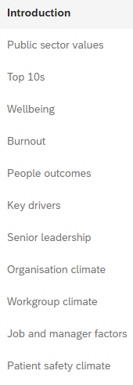
Results dashboards
Finding ‘agreement’ and ‘satisfaction’ results
All agreement and satisfaction questions can be found under their respective framework header:
People outcomes
Senior leadership
Organisation climate
Workgroup climate
Job and manager factors
Patient safety climate (health only).

Slide 17
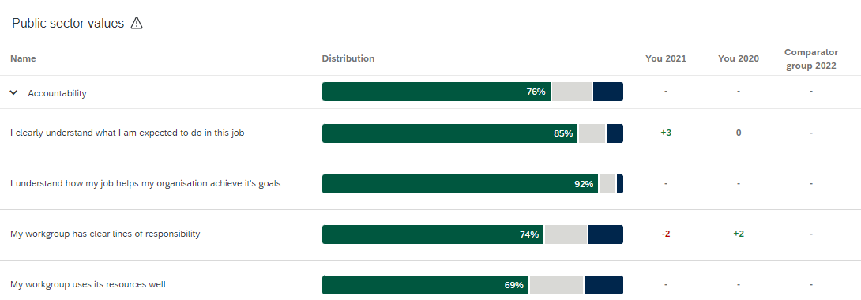
Results dashboards
Understanding ‘agreement’ and ‘satisfaction’ results
All agreement and satisfaction results show you the overall percentage of positive responses to a group of questions, as well as the percentage of positive responses to each individual question.
You can compare your results to a range of indicators.
Drill down
Overall positive response
Comparisons

Slide 18
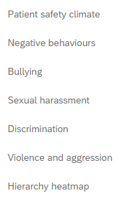
Results dashboards
Finding negative behaviour results
All negative behaviour results can be found in their respective sections:
Negative behaviours (overview).
Bullying.
Sexual harassment.
Discrimination.
Violence and aggression.

Slide 19
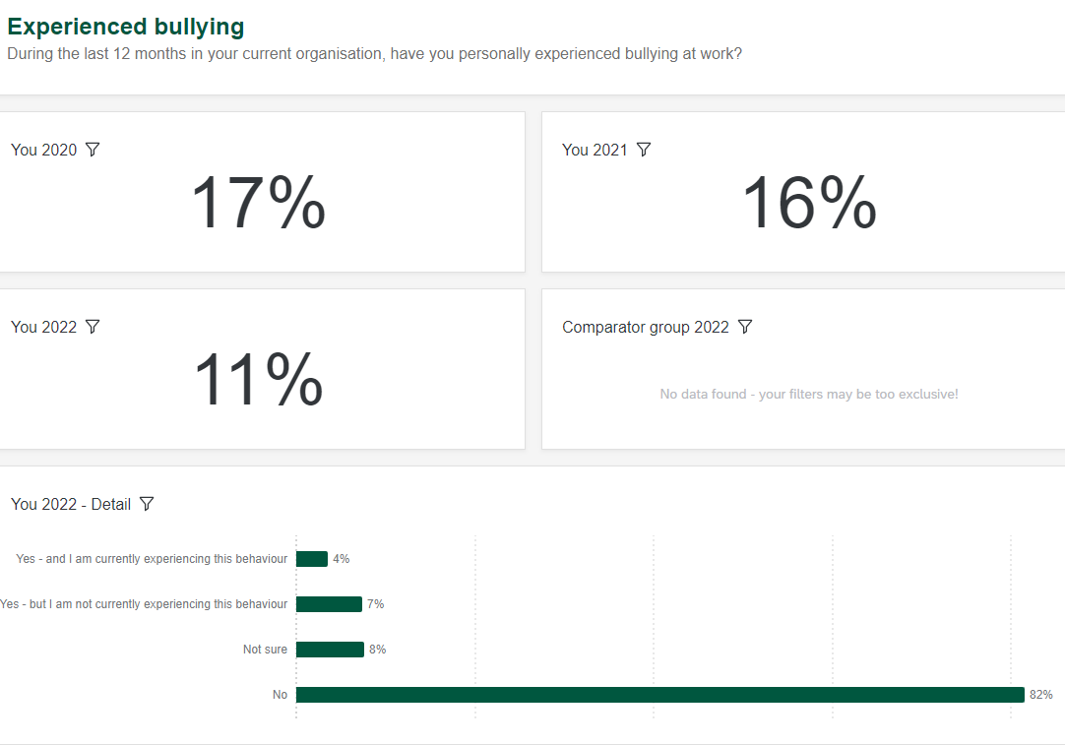
Results dashboards
Overall percentage of people experiencing
Understanding negative behaviour results
All negative behaviour results show you the overall percentage of people who experienced the behaviour, as well as a range of information on the nature of the behaviour.
This includes the type and frequency of the behaviour, as well as submissions of a formal complaint.
Further information

Slide 20
Results dashboards
Finding sub-unit (employee group) results
The results for sub-units are summarised in the Hierarchy heatmap page.

Slide 21
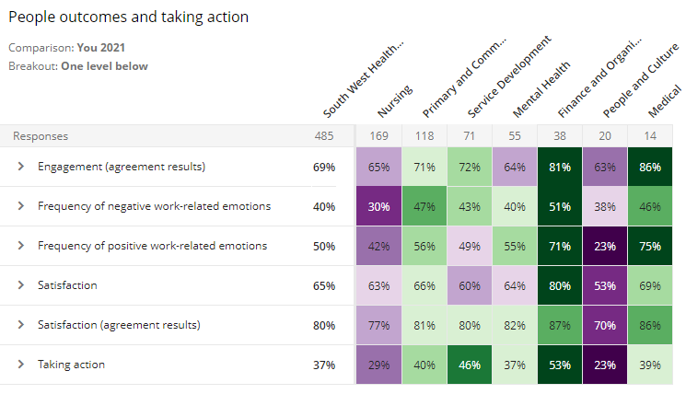
Results dashboards
Understanding the hierarchy heatmap
Overall positive response
Sub-units
The hierarchy heatmap shows you results for the group currently selected in the 'Results for:' hierarchy filter (e.g,. your organisation or team) and the results of sub-units below the group selected.
All results shown are positive results.
Drill down

Slide 22
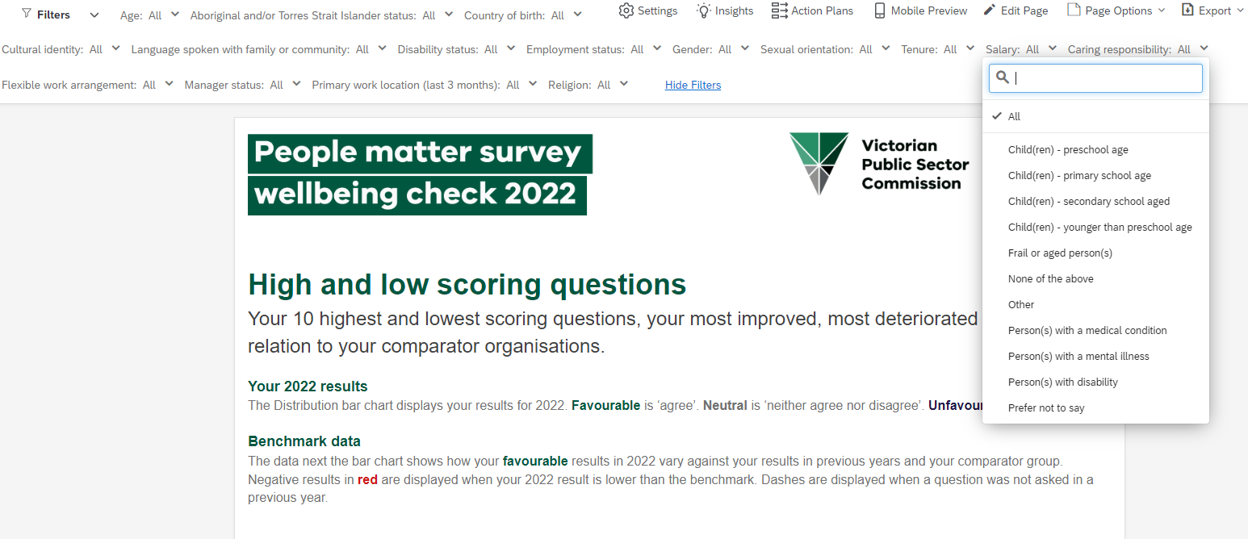
Results dashboards
Understanding anonymity in the ‘2022 Results with diversity filters’ dashboard
This dashboard allows you to filter on multiple demographics.
There is an anonymity threshold of 10. This means that if there are less than 10 responses in any demographic, results for these demographics will be grouped together for anonymity.
Tip: Use less filters if you see no results for a question.

Slide 23
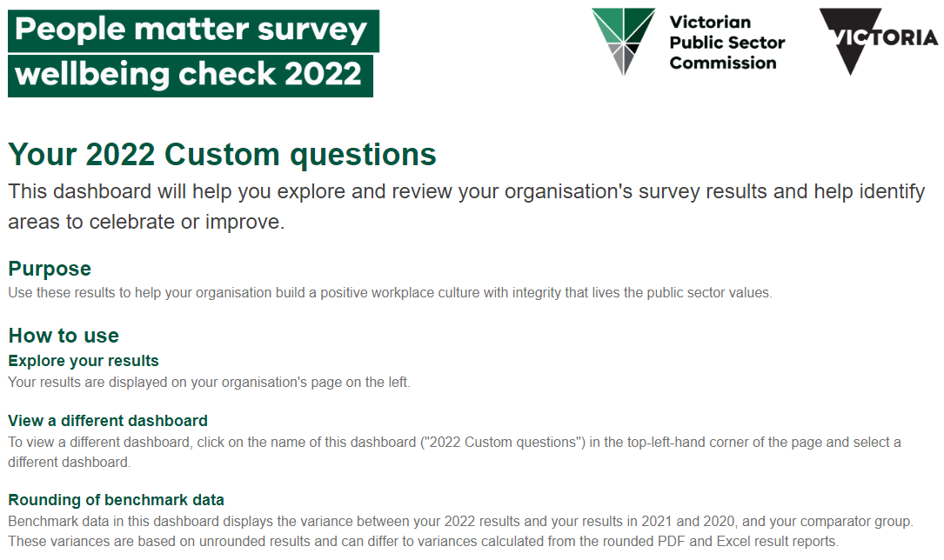
Custom questions dashboards
If your organisation asked any custom questions as part of the survey, you'll also have access to custom question dashboards.
All custom questions on one page

Slide 24
Custom questions dashboards
Two separate custom question dashboards
2022 Custom question results dashboard
Use the 'Results for:' filter to review custom question results for sub-units in your organisations hierarchy.
2022 Custom question results with diversity filters dashboard
Use the filter custom to review results for a range of demographics.
Tip: Deselect any option by clicking on it, any previous option you chose may not automatically deselect

Slide 25
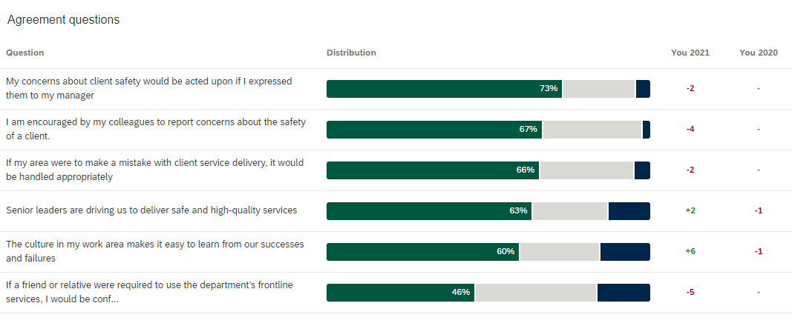
Custom questions dashboards
Positive responses
Custom question results follow the same format as questions in your overall results dashboard.
Comparisons

Slide 26
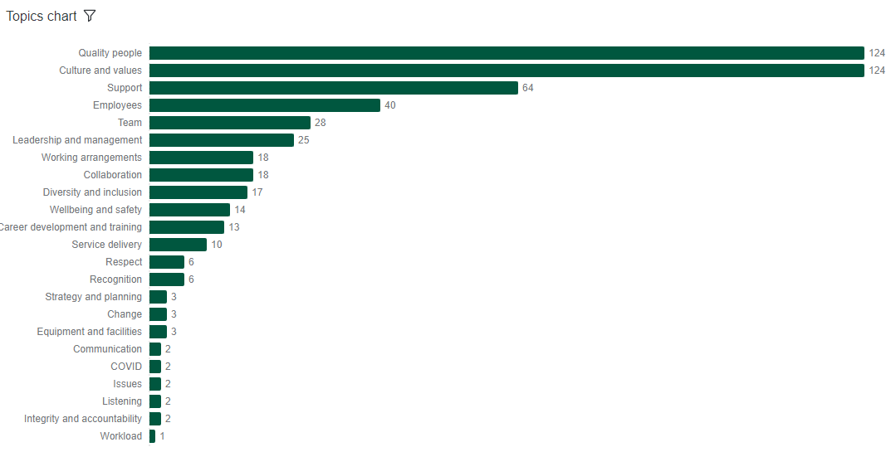
Free text comments dashboard
Verbatim free text comments can be filtered by topic and key word using the word cloud.
The verbatim responses are displayed at the bottom of the page.
Filters are displayed at the top of the page.
Access to this dashboard is only available to the head of your organisation.

Slide 27
How to export your results

Slide 28
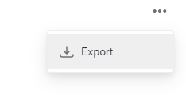
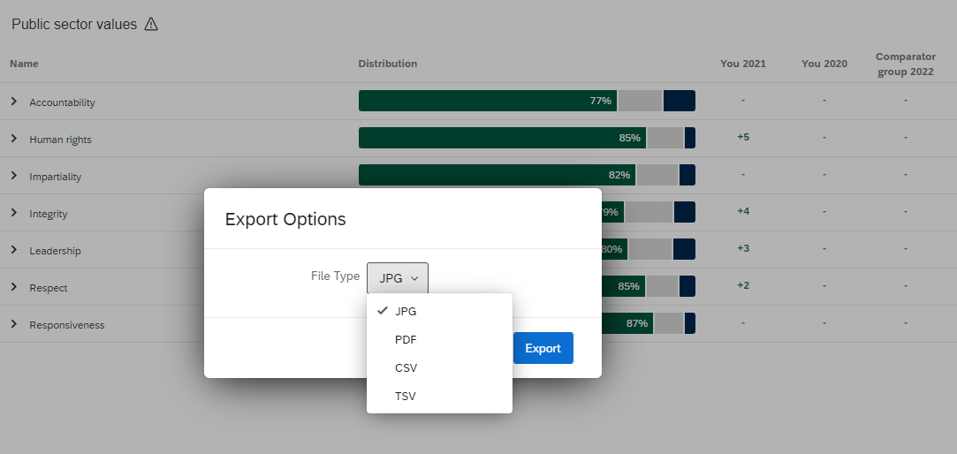
Exporting individual graphs / images
You have the option to export any of the individual graphs or visualisations in the dashboard into a range of formats, including PDF.
You will find the export graphs functionality when you expand the three dots in the top right of each graph.

Slide 29
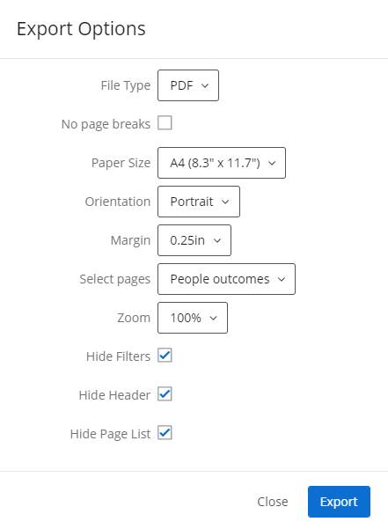
Exporting pages
You also have the option to export any or all of your dashboard pages to PDF or JPG.
You will find the export page functionality in the top right of each dashboard next to Page Options.
Choose file type
Customise the size
Choose one or all pages
Tip: Large reports take longer to export, keep your browser open.

Slide 30
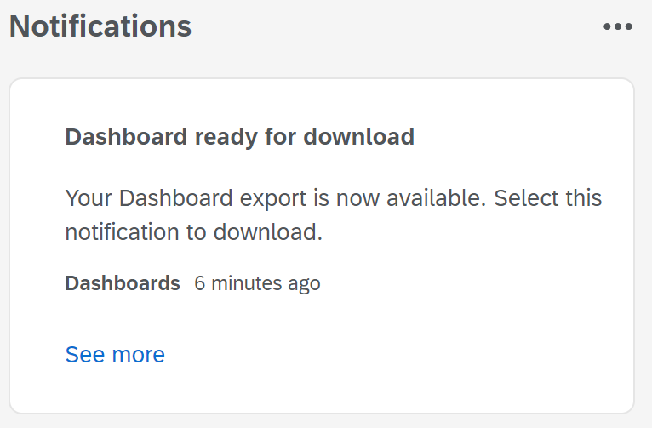
Exporting notifications
When your dashboard export is ready for download, you’ll see a notifications message at the top right of the screen.
Click on ‘See more’ in the Notifications box to download your files.
You can continue to use the dashboards while waiting for the download to complete.
Click on notifications to open your message.
Click on ‘See more’ to download your files.

Slide 31
Privacy and anonymity
How we protect your privacy and anonymity
To protect your anonymity and ensure people can't identify you in this reporting we:
de-identify individual survey responses
only provide free-text data separate to other survey data
don't release team or demographic group results when there are fewer than 10 responses (for example, a demographic group could be all men aged 40-49)
don't release demographic results, if fewer than 30 people in your organisation do the survey
don’t collect your name, date of birth or employee ID.
Read more in our privacy policy.

Slide 32
Find out more
Find information and resources at:
https://vpsc.vic.gov.au/data-and-research/about-the-people-matter-survey/
Find 2021 survey results at:
https://vpsc.vic.gov.au/data-and-research/people-matter-survey-data-2021/
Contact us:
people.matter@vpsc.vic.gov.au

Slide 33
End of presentation

