Slide 1

<DAY DATE YEAR> to <DAY DATE YEAR>
CONTACT: <NAME>
EMAIL: <EMAIL ADDRESS>

Slide 2
What is the People matter survey
Your independent employee opinion survey run by the Victorian Public Sector Commission
Employees from Victorian public sector organisations can take part
In 2024, over 108,000 employees from 242 organisations took part in the survey
People matter helps your organisation better understand employee engagement to provide the best possible work environment for you
It asks questions about your experience of:
career development
diversity and inclusion
flexible working
equal opportunity employment
manager support
wellbeing
workplace culture.

Slide 3
Why do the People matter survey
Your organisation will use the survey to:
support and listen to you
gain valuable feedback on your workplace experience
find out what it’s doing well and where it needs to focus on improvement to support your wellbeing.
Your organisation's survey results are:
benchmarked within your organisation, and with similar organisations across the public sector
publicly released on the Commission's website to promote transparency on the strengths of organisations and where they can improve.
Why your opinion matters:
your responses help shape important decisions in your organisation and the Victorian public sector
you’ll be asked how well our public sector values are practiced across your organisation
it’s a safe and anonymous way for you to tell your organisation what you think about your workplace experience.

Slide 4
What’s new in 2025
Features of the 2025 survey:
questions supporting Gender Equality Act 2020 audit and reporting requirements
improved question wording
improved privacy and anonymity explanations.
You can:
access the survey via weblink or QR code
use your mobile to complete the survey.
Key dates:
survey runs from Monday 28 April until midnight Friday 16 May 2025.
reports available to your organisation in June 2025.
The survey should take about 20 minutes to complete.

Slide 5
Privacy and anonymity

Slide 6
What questions do we ask
The survey will ask questions:
about where you work in your organisation
about you, such as age and other demographic questions
about your employment, such as management responsibility and salary.
We understand your answers to many of these questions are personal and private.
Which is why when you do the survey, we protect your anonymity and privacy rights in line with the Privacy and Data Protection Act 2014 and the Health Records Act 2001.

Slide 7
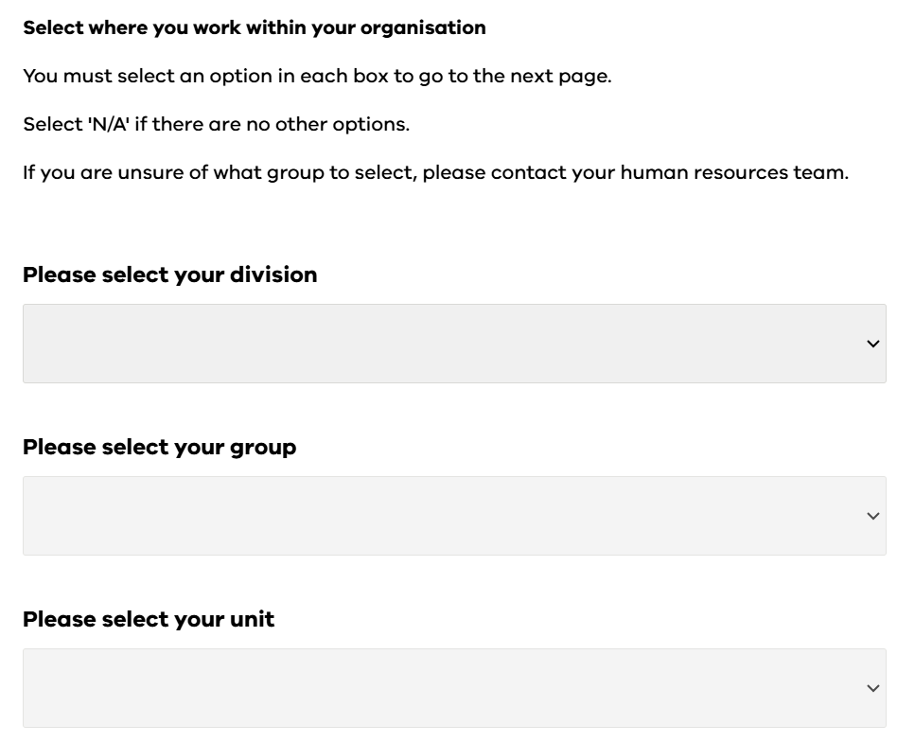
We ask about where you work in your organisation
What do we ask?
We ask for your:
Division
Group
Unit
Why do we ask?
To help your organisation improve, it's important to know what unit you work in.
This will help your leadership assess and respond to risks and issues across the organisation.

Slide 8
We ask questions about you
What do we ask?
We ask:
about your age, gender and sexuality
if you identify as a person with disability
about your cultural identity
if you identify as Aboriginal and/or Torres Strait Islander
where in Victoria you work
how you are employed and for how long.
Why do we ask?
Organisations use this data to improve diversity and inclusion in the public sector.
This can include things like how we support equal opportunity, reduce discrimination and promote fairer recruitment.
The data is used to support the work of organisations such as:
Gender Equality Commission
Victorian Multicultural Commission
Victorian Equal Opportunity and Human Rights Commission,
Office for Disability
Commission for LGBTIQ+ Communities

Slide 9
How we protect your privacy and anonymity
Your answers are anonymous
Be confident to tell us about your experiences in your organisation.
Our data rules stop you being identified when we ask things about you, such as your age, gender and cultural identity.
We send you an anonymous survey link
Everyone uses the same anonymous link to take part in the survey.
We de-identify all data your organisation gets
We don't collect your name, date of birth or employee ID.
We separate open-text responses from other data
Your organisation won’t know you made the comments.
We never publish individual survey responses
This means your organisation can’t identify you when we report on the data.
We limit the data organisations get
If fewer than 30 people in your whole organisation do the survey, we don’t give a breakdown by any demographic group of how many people did the survey.

Slide 10
'I’m being asked for my age, my salary, my team, my gender, and a whole lot more. Will I identify myself?'
You can be confident to give these details, as we only give aggregated, overall results (e.g., % agree) for groups of 10 or more.
If fewer than 10 people in a team or demographic group do the survey, we don't release employee experience results.
For example, a demographic group is ‘men in the same salary range’ or ‘women aged 40 to 49’.
An experience result is ‘90% of women aged 40 to 49 agreed their manager supports them’.
You're encouraged to respond honestly about your individual experience.
And you always have the option to respond to questions such as age, gender, sexuality and cultural identity with 'prefer not to say'.
However, by selecting ‘prefer not to say’, you reduce the survey’s ability to show whether different groups of people have different workplace experiences.

Slide 11
Data collection
Data collection statement
The Commission’s Data collection statement tells you:
why we conduct the survey
what data we collect
how we collect, store and manage your data
how we protect the anonymity of your survey responses.

Slide 12
Find out more
Find information and resources at:
https://vpsc.vic.gov.au/data-collection/about-the-people-matter-survey/resources-for-survey-coordinators/
Find information about results from the 2023 People matter survey at:
https://vpsc.vic.gov.au/data-and-research/people-matter-survey-data/
Contact us:
people.matter@vpsc.vic.gov.au

Slide 13
End of presentation

